Slide 1
The Sign of Great Parenting Is Not The Child’s Behaviour.
The Sign of Truly Great Parenting is the Parents’ Behaviour.

Slide 2
Children are Great Imitators
So Give Them Something Great To Imitate

Slide 3
To be in our children’s memories tomorrow
You have to be in their Lives today

Slide 4
Your Words as Parents Have Great Power
Use them to Support and Inspire
Notes:
AND

Slide 5
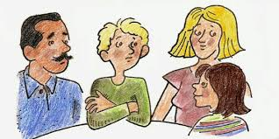
If you
want your children to improve
Let them Overhear the Good Things you Say about Them to Others

Slide 6
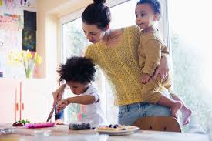
Behind ever Young Child who Believe in
Herself is a Parent who Believed First

Slide 7
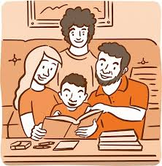
When Disciplining Your Child
don’t raise Your Voice
Improve your Argument.

Slide 8
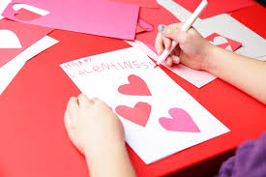
The Best Way to Raise Positive
Children in a
Negative World is
to have Positive Parents who Love them Unconditionally and Serve them as Excellent Role Models

Slide 9
When your Kids Won’t Listen
Create a
No Yelling
Home!

Slide 10
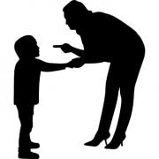
Dear Children,
The More You Discipline Yourself
The Less You will be Disciplined by Others

Slide 11
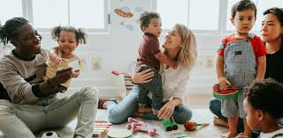
Dear Children,
All of Your Successes and Failures are the Results of the Habits You have Formed.
So Act Smart.

Slide 12
Dear Parents
Positive Words are Forms of Actions, Capable of Influencing Change.

